Slide 1
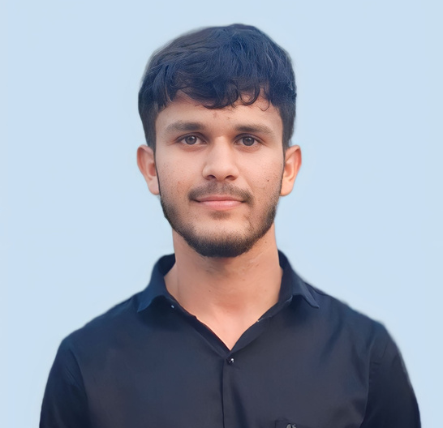
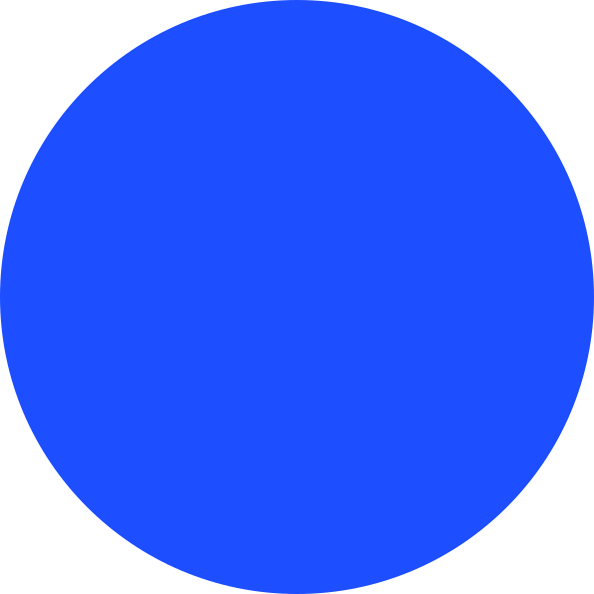








NOFAL BASAN
Full Stack Developer
Passionate About Web Development Goal is To Archive A Good Position By Doing Satisfying Work In The IT Field.
EDUCATION
CONTACT
2021 - 2024
B.sc (CA & IT)
H.N.G.U
8.0/10.0 SGPA
+91 9427628497
2165 Basanvas, AT-Rajosana
PO - Pirojpura
PROJECTS
basannofal@gmail.com
basannofal (Nofal Basan) · GitHub
TailorG (Mobile Application)
https://www.linkedin.com/in/basan-nofal-7a6b65232/
Technology :- React Native, Node js, mongodb, Express js
TailorG is a mobile application for all Tailor. Tailor can perform various operation in App like add new customer, take customer order, take measurment of clothes, add new cloth pattern etc..
https://stackoverflow.com/users/19645465/basan-nofal
SKILLS
E-Govenment (Web Application)
Technology :- React Js, Node js, Mongodb, Express js
E-Government website created for hackathon. This is biggest web application. it has multifunctionality.
MERN Stack
React Native
Java
SQL
Blog Website (Web Application)
Technology :- React Js, Node js, My SQL, Express js
Bog website work as wordpress tools. it has multiple functionality to create blog and SEO for blog.
SOFT SKILLS
Other Projects Hosted in Github : click here
Self Learning
Problem solving
teamwork
https://codinghelps.com/
WORK EXPERIENCE
CERTIFICATE
2022 - Present
Full Stack Developer
IIT Roorkee Web Application
Valuda's Technology Park | Chhapi
Develop and Modify 20+ web application and custom component
learned organization's overall strategies business operates and what drives success in the business
SSIP Hackathon Final Round

